Slide 1
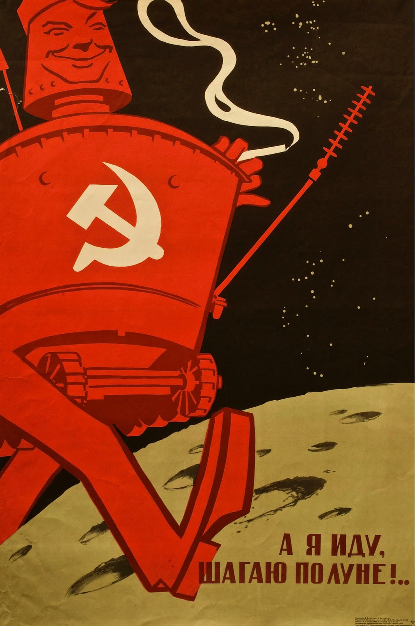


Project 2
How did Russia attempt to influence Americans online?
Analysis of Russian psychological operations on reddit during the 2016 us presidential election

Slide 2
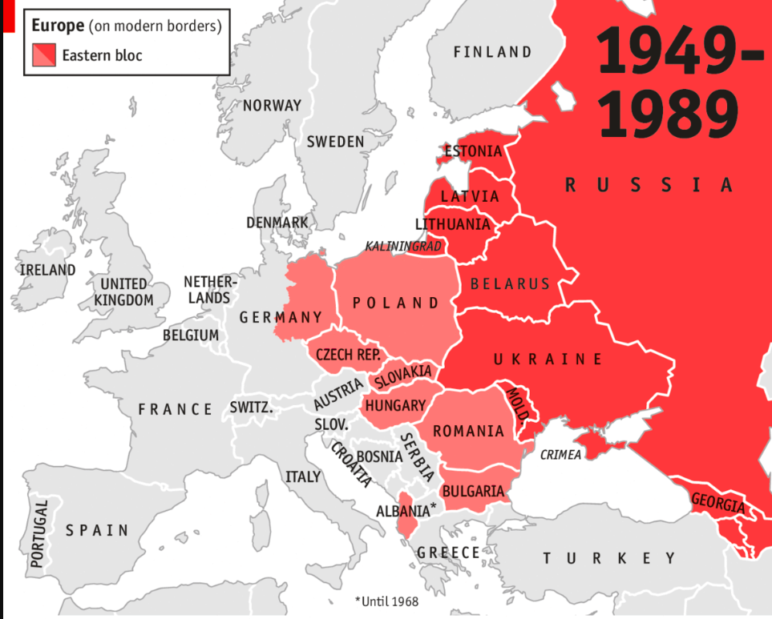
Russia
Cold War era

Slide 3
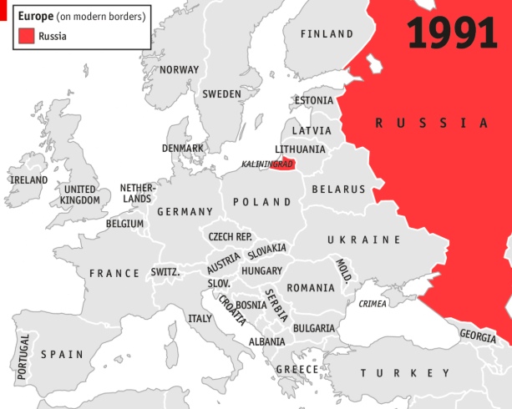
Russia
Post cold war

Slide 4
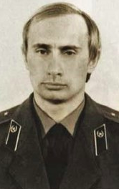
The change of power
KGB
Stationed in East Berlin During Fall of Berlin Wall
The most often cited estimate comes from a former mid-level Kremlin adviser named Stanislav Belkovsky. In 2007, he claimed Putin had a fortune worth at least $40 billion—a figure that would put him in the top 10 of Forbes magazine’s ranking of billionaires.
-cnn.money
“There is no such thing as a former KGB man” - Vladimir Putin
Recently invaded Crimea
Many experts believe Putin wants to return to cold war era borders
Putin assumes office
First
2000 - 2008
Then again
2012 - Present

Slide 5
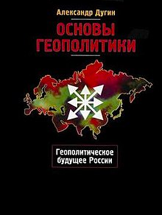
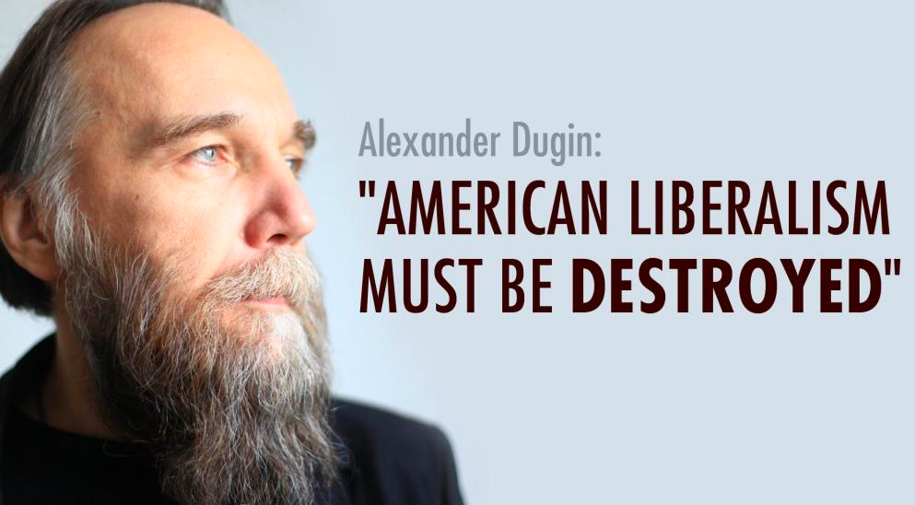
Meet
“Foundations of GeoPolitics” is required reading for Russian Military Officers
Calls for the dismantling of NATO and rebuilding of former Soviet Union
Aleksandr Dugin
Part of Putin’s inner circle

Slide 6
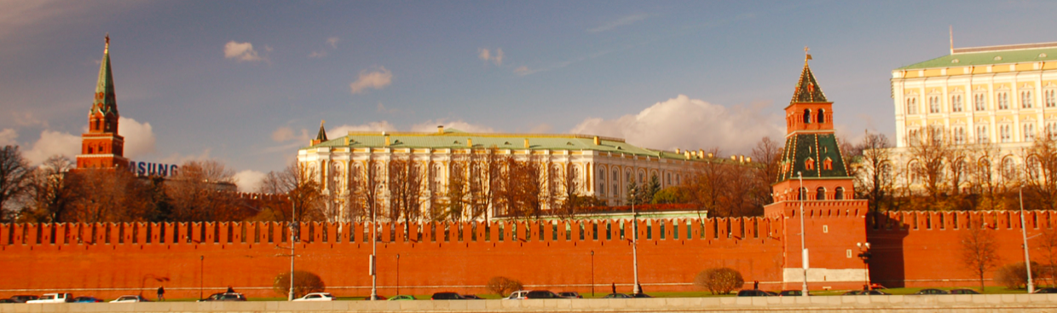
FOUNDATIONS OF GEOPOLITICS LAYS
OUT RUSSIA’S GEOPOLITICAL GOALS:
The United Kingdom should be cut off from Europe.^{[9]}
Romania, Macedonia, "Serbian Bosnia" and Greece – "Orthodox collectivist East" – will unite with "Moscow the Third Rome" and reject the "rational-individualistic West"
Ukraine should be annexed by Russia because "Ukraine as a state has no geopolitical meaning, no particular cultural import or universal significance, no geographic uniqueness, no ethnic exclusiveness, its certain territorial ambitions represents an enormous danger for all of Eurasia and, without resolving the Ukrainian problem, it is in general senseless to speak about continental politics". Ukraine should not be allowed to remain independent, unless it is cordon sanitaire, which would be inadmissible
China, which represents a danger to Russia, "must, to the maximum degree possible, be dismantled". Dugin suggests that Russia start by taking Tibet–Xinjiang–Mongolia–Manchuria as a security belt.^{[1]} Russia should offer China help "in a southern direction – Indochina (except Vietnam), the Philippines, Indonesia, Australia" as geopolitical compensation
In the United States:
Russia should use its special services within the borders of the United States to fuel instability and separatism, for instance, provoke "Afro-American racists". Russia should "introduce geopolitical disorder into internal American activity, encouraging all kinds of separatism and ethnic, social and racial conflicts, actively supporting all dissident movements – extremist, racist, and sectarian groups, thus destabilizing internal political processes in the U.S. It would also make sense simultaneously to support isolationist tendencies in American politics"

Slide 7
FOUNDATIONS OF GEOPOLITICS LAYS
OUT RUSSIA’S GEOPOLITICAL GOALS:
In the United States:
Russia should use its special services within the borders of the United States to fuel instability and separatism, for instance, provoke "Afro-American racists". Russia should "introduce geopolitical disorder into internal American activity, encouraging all kinds of separatism and ethnic, social and racial conflicts, actively supporting all dissident movements – extremist, racist, and sectarian groups, thus destabilizing internal political processes in the U.S. It would also make sense simultaneously to support isolationist tendencies in American politics"

Slide 8
The data should show, an effort to fuel instability and separatism. To provoke “Afro-American racists” To encourage all kinds of separatism and ethnic, social and racial conflicts, actively supporting all dissident movements - extremists, racists, and sectarian groups - while simultaneously support isolationist tendencies in American politics

Slide 9
WHo says?

Slide 10
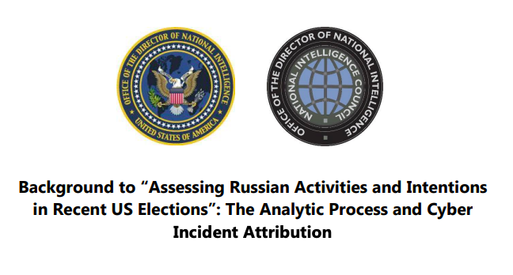

Slide 11
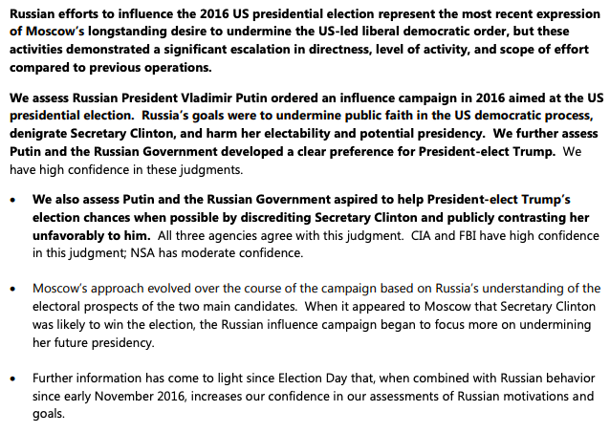

Slide 12
Where did we find the data?

Slide 13
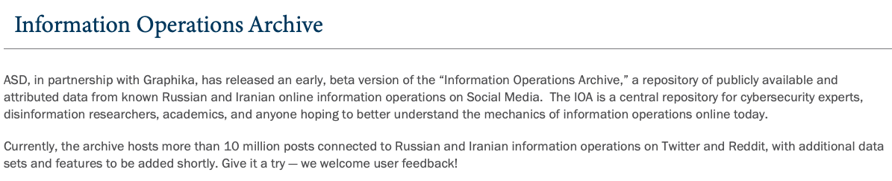

GMF
The GERMAN Marshal Fund
In 2016, American democracy came under unprecedented attack.
The government of the Russian Federation attempted to weaken the pillars of our democracy and undermine faith and confidence in our society’s most fundamental right — the ability to choose our own leaders.
This effort was only the latest of Russia’s repeated and ongoing efforts to undermine democratic institutions and influence free and democratic elections throughout Europe. Its success has led Vladimir Putin and other authoritarian regimes, in particular, to conclude that disruption is effective, and comes with little consequence.

Slide 14





What we used
The tools

Slide 15
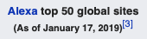

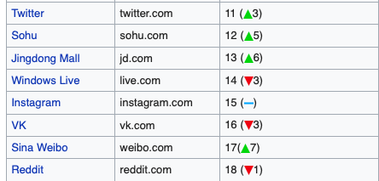
WHAT IS REDDIT?
Most popular forum style
Users can comment on News, and Popular Memes
18th most visited website in the world
American social news aggregation, web content rating, and discussion website. Registered members submit content to the site such as links, text posts, and images, which are then voted up or down by other members. Posts are organized by subject into user-created boards called "subreddits", which cover a variety of topics including news, science, movies, video games, music, books, fitness, food, and image-sharing. Submissions with more up-votes appear towards the top of their subreddit and, if they receive enough votes, ultimately on the site's front page. Despite strict rules prohibiting harassment, Reddit's administrators spend considerable resources on moderating the site.^{[4]}

Slide 16

What we found
Story
DATA SHOWS RUSSIA Likes to get cozy first
They
Like
Cat
Pictures

Slide 17
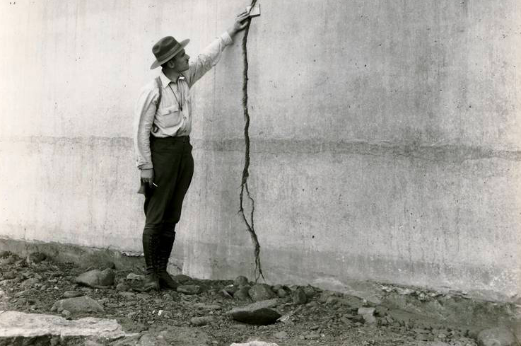
Then they divide us
Russian active measures accounts find the cracks in American culture and exploit them

Slide 18
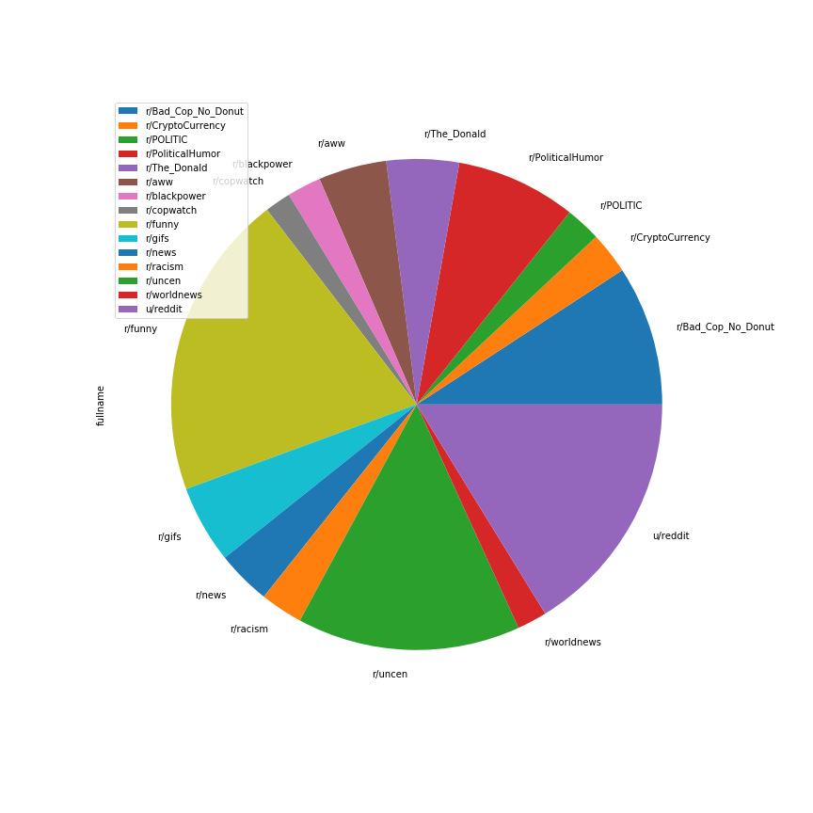
Most Used
Subreddits
Are
Funny
SubReddits
Used to
Make
Fake
Accounts
More
Real
And Gain
An Audience’s
Trust

Slide 19
Subreddit dedicated to Donald Trump was the 5th most popular.
The subreddit is known for its divisive racism, anti-semitism,
sexism, xenophobia, and they commonly refer to Donald Trump as ‘The God Emperor’

Slide 20
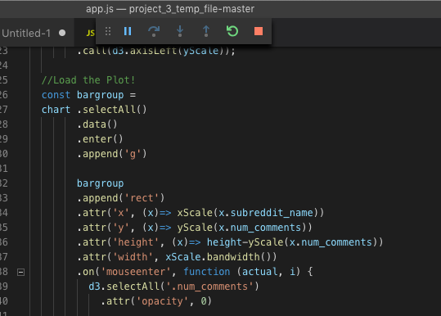
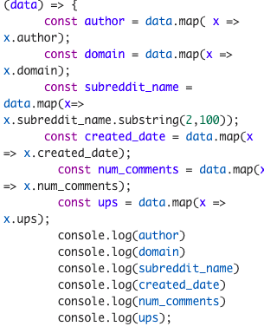
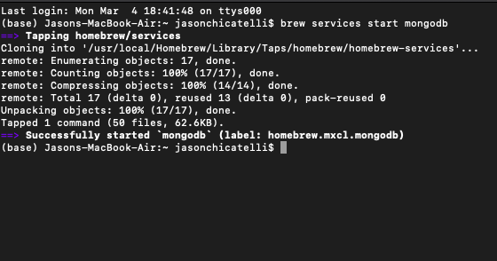
TO THE WEBSITE!

Slide 21
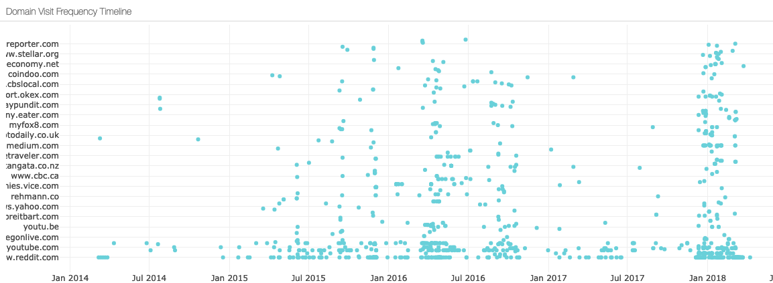
Timeline shows
Russia stepped up operations for the 2018
Midterm elections

Slide 22
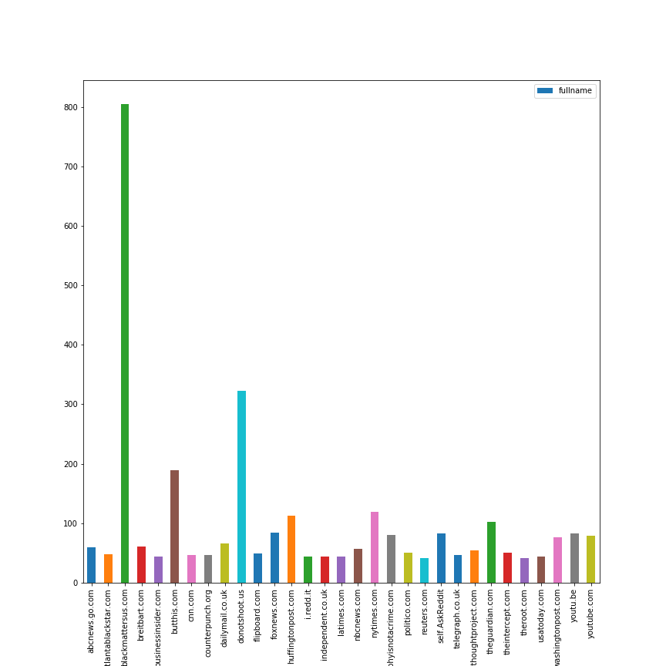
The data confirms: Russia wants to manipulate and divide America
The most shared URL is a fake website made by Russia: blacklivesmatterus.com
The website organized real protests here in America

Slide 23

The 6th most popular subreddit for Russian operations
Is r/aww, dedicated to cat pictures and cute animals.
But the most popular subreddit.

Slide 24
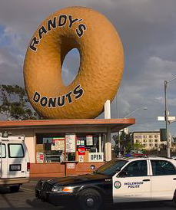
Bad_cop_no_donut
Showing they divide on all sides and want to sow distrust in our rule of law, and distrust between our diverse communities

Slide 25
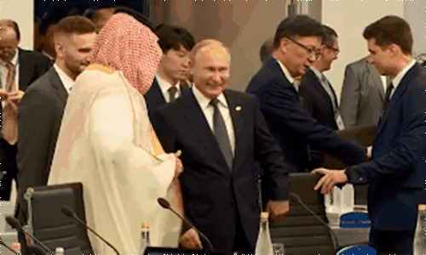
Data confirms
PROJECT
Russian accounts interfered with elections to divide Americans
General
Nov 2016
Midterm
Nov 2018

Slide 26
